Slide 1

Job hunting for Data Analysts:
Why it's hard and what one can do about it
February 19, 2022
11:00 am - 1:00 pm (GMT +3)

Slide 2


Agenda
Time | Activity | Speaker/ Moderator
11:00 am – 11:05 am | Participants joining | Maggie Wanjiru
11:05 am – 11:15 am | Welcoming remarks and introducing the speaker | Shel Kariuki
11:15 am – 12:00 pm | Talk | Oscar Baruffa
12:00 pm – 12:30 pm | Q & A | Shel Kariuki
12:30 pm – 12:40 pm | Closing remarks | Njoki Lucy

Slide 3
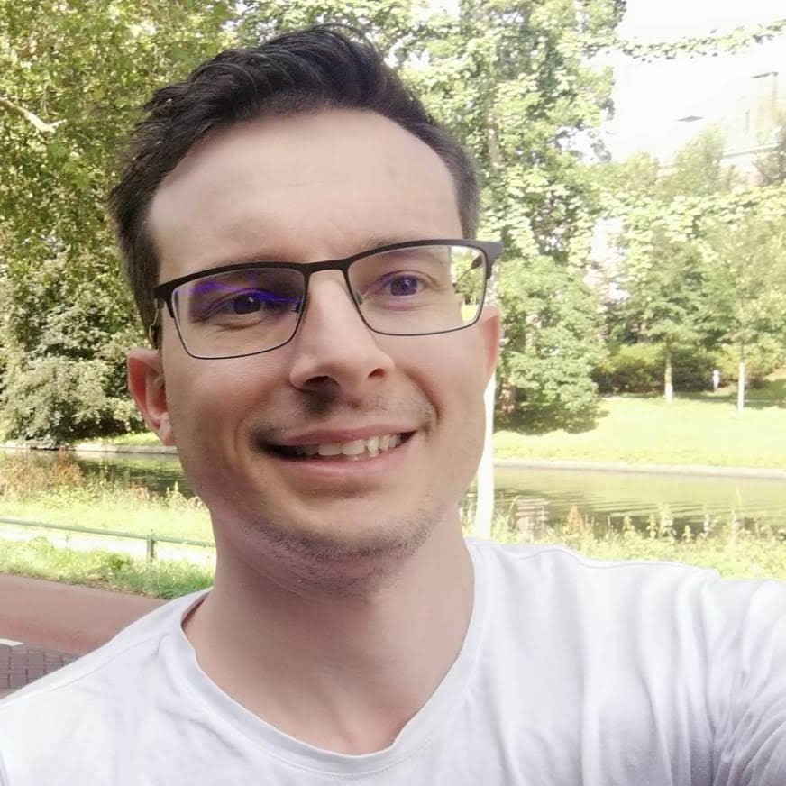
Our Speaker
Oscar Baruffa
Data Specialist

Slide 4
Talk Session

Slide 5
Q & A

Slide 6
THANK YOU!!
Email address: nairobi@rladies.org
LinkedIn: R-Ladies Nairobi
Twitter: @RLadiesNairobi
Meetup: https://www.meetup.com/rladies-nairobi/
Source for the icons used: https://www.flaticon.com/free-icons/

